Slide 1

Button; Listbox - GUI Applications
Python Programming | GUI Applications
Course: Python Programming | Chapter: GUI Applications | Bachelor of Computer Science and Engineering
DISCOVER · LEARN · EMPOWER
Notes:
Welcome everyone to today's session on GUI Applications. We will focus specifically on two fundamental widgets: Buttons and Listboxes. These components are the backbone of user interaction in any Python application. Remember, our motto at Chandigarh University is to Discover, Learn, and Empower through technology.

Slide 2
Course Outcomes
SLIDE 2 / 14
Course Outcome
CO | BT LEVEL | DESCRIPTION
CO1 | BT1 | Understand the syntax, control structures, and basic constructs of Python programming language
CO2 | BT3 | Apply functions, modules, and exception handling for modular program development
CO3 | BT3 | Implement data structures including lists, tuples, dictionaries, and sets for efficient data processing
CO4 | BT4 | Analyze and manipulate files, strings, and perform data handling operations
CO5 | BT5 | Design and develop real-world applications integrating multiple Python concepts
Chandigarh University
2 / 14
Notes:
Today's lecture directly addresses two specific Course Outcomes. First, CO4 requires us to analyze and manipulate files, strings, and perform data handling operations, which we will see when populating listboxes. Second, CO5 focuses on designing and developing real-world applications integrating multiple Python concepts, which is the essence of building a GUI.

Slide 3
Learning Objectives
SLIDE 3 / 14
Learning Outcomes
1
Define the functional role of Button and Listbox widgets in GUIs
2
Analyze the event-driven mechanism behind button click actions
3
Construct a Listbox to display dynamic data from a list
4
Evaluate common pitfalls when binding commands to interactive widgets
5
Develop a sample interface integrating both widgets for user input
Chandigarh University
3 / 14
Notes:
By the end of this lecture, you will be able to define the specific roles of these widgets. We will analyze how the event loop processes a button click. You will also learn to construct a Listbox that dynamically displays data. Finally, we will evaluate common pitfalls to ensure your code is robust.

Slide 4
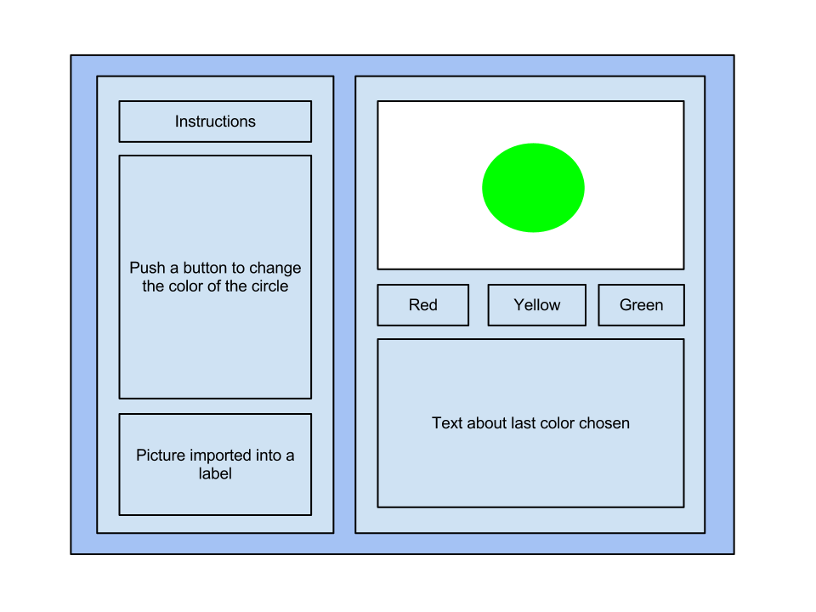
Lecture
SLIDE 4 / 14
Button Widget Fundamentals
1
A Button is a clickable widget that triggers a specific action or command
2
It requires a parent container, typically a Tkinter root window or frame
3
The command parameter links the button to a Python function for execution
4
Text displayed on the button is defined by the text argument in code
5
Buttons support various states like normal, active, disabled, and pressed
6
Visual appearance is customized using font, background color, and padding options
Basics of a Tkinter GUI
Chandigarh University
4 / 14
Notes:
Think of a Button as a physical switch in your software. When you click it, it sends a signal to execute a specific function. For example, a 'Submit' button triggers a validation function. Without the command parameter, the button is just a static image with no interactivity.

Slide 5
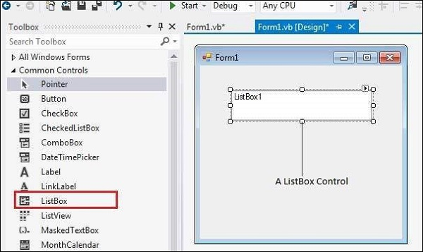
Lecture
SLIDE 5 / 14
Listbox Widget Fundamentals
1
A Listbox displays a scrollable list of items for user selection
2
It supports single selection or multiple selection modes via selectmode
3
Items are added dynamically using the insert method with index positions
4
The get method retrieves specific items based on their index or selection
5
Listboxes can be bound to events like double-click or listbox selection
6
Scrollbars are often paired with Listboxes to handle long content lists
VB.Net - ListBox Control (source: www.tutorialspoint.com)
Chandigarh University
5 / 14
Notes:
A Listbox is like a digital menu where users can pick one or more options. You can add items dynamically, which is crucial for handling variable data. For instance, a list of student names can be loaded from a file. The selectmode parameter determines if a user can pick just one name or multiple names.

Slide 6
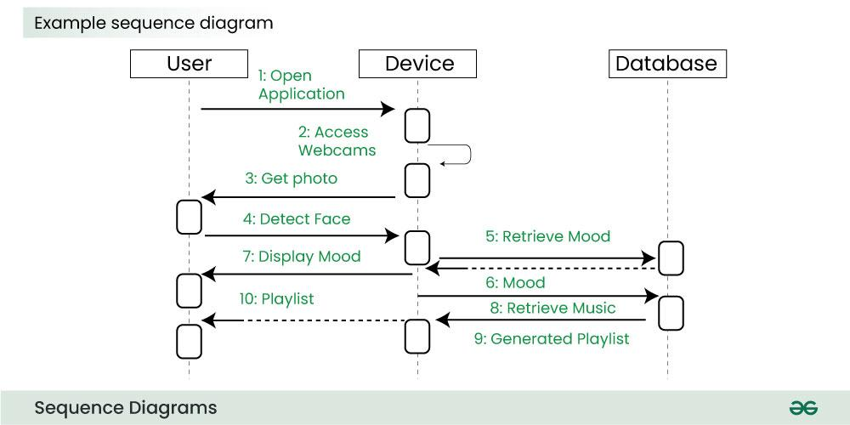
Lecture
SLIDE 6 / 14
Event Handling Mechanism
1
GUI applications rely on an event loop to listen for user interactions
2
The mainloop() function keeps the application window open and responsive
3
Clicking a button generates a Button-1 event processed by the callback
4
Selection changes in a Listbox generate ListboxSelect events for handling
5
Callbacks must be defined as functions that accept no arguments or self
6
The event loop runs continuously until the user closes the application window
Source: media.geeksforgeeks.org
Chandigarh University
6 / 14
Notes:
The magic happens in the event loop. When you click a button, the system pauses the loop, runs your function, and then resumes. This is why your function must not block the loop. If you put a long calculation inside a button command without threading, the GUI will freeze.

Slide 7
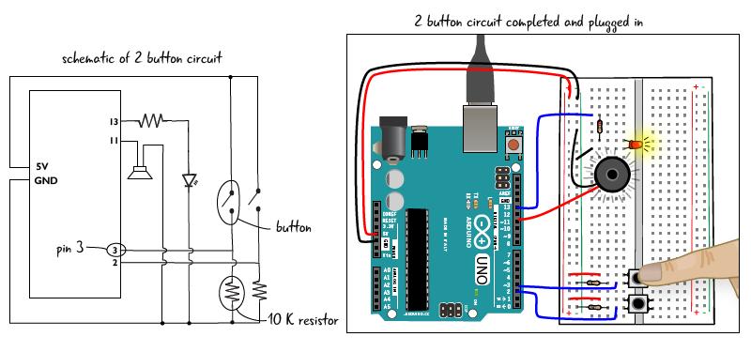
Worked Example
SLIDE 7 / 14
Button Logic
GOVERNING EQUATION
Create a button with command=calculate_sum to trigger the addition logic
1
Define a function calculate_sum that adds two numbers from entry fields
2
Retrieve values using entry.get() and convert them to integers for math
3
Display the result in a label widget after the calculation completes
4
Handle ValueError exceptions to prevent crashes if user enters non-numbers
5
The button acts as the bridge between user input and calculation logic
Source: arduinotogo.com
Chandigarh University
7 / 14
Notes:
Let's look at a concrete example. Suppose we have two entry fields for numbers 10 and 20. When the user clicks 'Add', the button calls a function. This function retrieves the strings, converts them to integers, adds them to get 30, and updates a label. This demonstrates the core interaction pattern.

Slide 8
Worked Example
SLIDE 8 / 14
Listbox Population
1
Initialize a list of strings containing names like 'Alice', 'Bob', 'Charlie'
2
Create a Listbox widget and iterate through the list to insert items
3
Use listbox.insert(END, item) to append each name to the bottom
4
Bind a double-click event to print the selected name to the console
5
Use listbox.curselection() to get the index of the currently selected item
6
This approach allows dynamic data display without hardcoding every list item
VB.Net - ListBox Control (source: www.tutorialspoint.com)
Chandigarh University
8 / 14
Notes:
Here is how we populate a listbox. We start with a Python list of names. We loop through this list and insert each name into the widget. If the list grows to 100 items, the listbox automatically handles the display. This is essential for CO4, as we are manipulating data structures to update the UI.

Slide 9
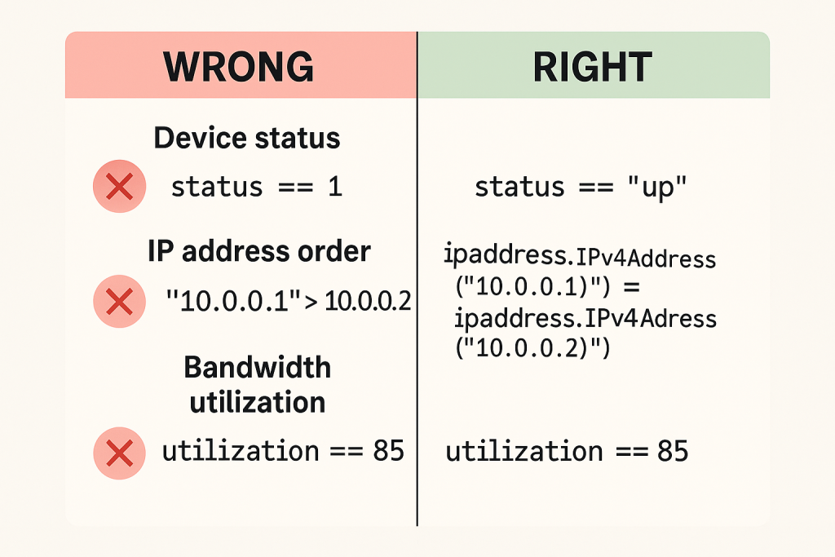
Common Pitfall
SLIDE 9 / 14
Command Binding
GOVERNING EQUATION
Writing command=func() executes the function immediately instead of on click
1
Do not include parentheses after the function name in the command argument
2
The correct syntax is command=func to pass the function reference only
3
Incorrect binding causes the function to run before the GUI is fully ready
4
This error often leads to a blank interface or immediate program termination
5
Always verify that the function signature matches the expected callback format
Source: richardkilleen.co.uk
Chandigarh University
9 / 14
Notes:
A very common mistake is adding parentheses to the command argument. If you write command=func(), the function runs immediately when the line is executed, not when you click the button. This often crashes the app because the window isn't ready yet. Always pass the function name without parentheses.

Slide 10
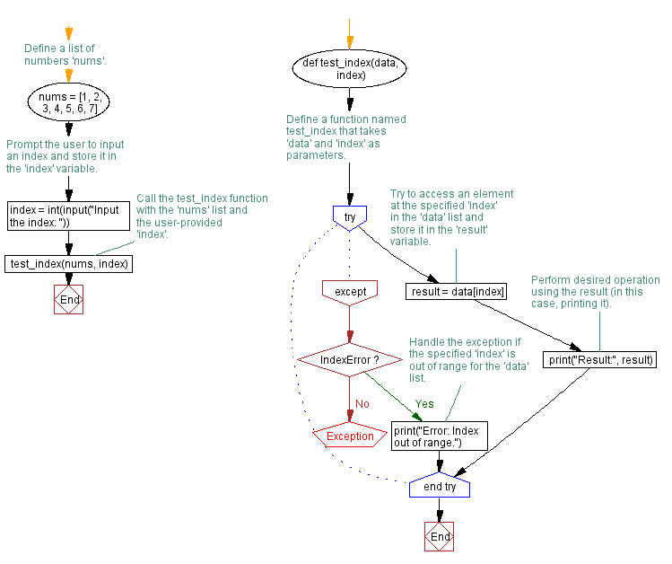
Common Pitfall
SLIDE 10 / 14
Index Errors
1
Accessing a Listbox item at an index that does not exist raises an error
2
The get method requires a valid index or a selection tuple from curselection
3
Always check if the selection is empty before trying to retrieve an item
4
Use try-except blocks to handle cases where no item is selected by user
5
Attempting to get index 5 when only 3 items exist causes an IndexError
6
Validating user input prevents runtime crashes during data retrieval operations
Source: www.w3resource.com
Chandigarh University
10 / 14
Notes:
Another frequent issue is the IndexError. If a user clicks a button to get a selected item but hasn't selected anything, the code will crash. You must check if the selection list is empty before calling get. This is critical for robust application design as per CO5.

Slide 11
Integration
SLIDE 11 / 14
Combining Widgets
1
Place a Listbox and a Button side-by-side within a single frame container
2
The button can trigger a function that reads the current Listbox selection
3
This integration allows users to select an item and perform an action
4
Use grid or pack geometry managers to align widgets neatly on the screen
5
The button acts as the trigger to process the data currently in the list
6
This pattern is common in forms where users select an option and submit
Chandigarh University
11 / 14
Notes:
Now let's combine them. Imagine a list of products and a 'Buy' button. The user selects a product from the listbox and clicks the button. The button's command function reads the selection and processes the purchase. This integration is the core of many real-world applications.

Slide 12
Lecture
SLIDE 12 / 14
Data Handling with Listbox
1
Retrieve all items from a Listbox using the get method with range indices
2
Iterate through the selected items to perform bulk data processing operations
3
Delete specific items from the listbox using the delete method with indices
4
Clear the entire listbox content using the delete method with range 0 to END
5
This capability supports file handling operations required by Course Outcome CO4
6
Dynamic updates allow the GUI to reflect changes in underlying data structures
Chandigarh University
12 / 14
Notes:
Listboxes are powerful for data handling. You can retrieve all items, process them, or delete specific entries. For example, you might have a list of files and a button to delete a selected file. This directly supports the requirement to analyze and manipulate data structures within our applications.

Slide 13
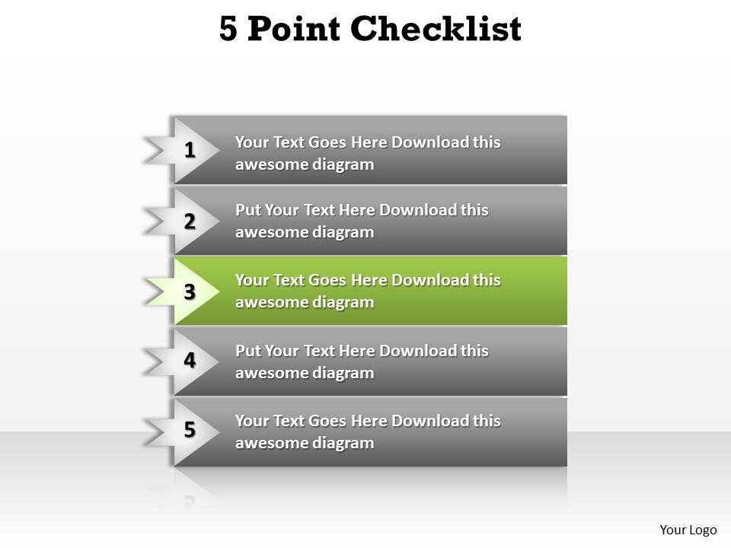
Lecture
SLIDE 13 / 14
Key Takeaways
1
Buttons trigger actions via the command parameter without parentheses
2
Listboxes display dynamic data and support single or multiple selections
3
Event loops manage user interactions and keep the GUI responsive
4
Always validate selections to prevent IndexError exceptions in code
5
Integration of widgets enables complex data handling and user workflows
Source: www.slideteam.net
Chandigarh University
13 / 14
Notes:
To summarize, remember that buttons need the command parameter without parentheses. Listboxes are great for dynamic data display. The event loop is the heart of the GUI. Always check for empty selections to avoid crashes. Finally, combining these widgets allows you to build powerful, real-world applications.

Slide 14
Lecture
SLIDE 14 / 14
References
PYTHON
A Practical Learning Approach, 1st Edition — T.S. Murugesh, Shriram K. Vasudevan, Sini Raj Pulari
• Learning Python, 6th Edition — Mark Lutz
• Starting Out with Python, Global Edition, 6th Edition — Tony Gaddis
• Introduction to Python Programming and Data Structures, 3rd Edition — Y. Daniel Liang
Chandigarh University
14 / 14
Notes:
For further reading, please refer to the textbooks listed here. Mark Lutz's book is excellent for deep Python knowledge. Tony Gaddis provides a great introduction. Y. Daniel Liang covers data structures well. Finally, the practical approach book by Murugesh et al. offers specific insights for engineering students.

